Slide 1
Non-abelian states of matter – Principles and examples
Ady Stern (Weizmann)

Slide 2
Outline
Short advertisement
The rest of the talk

Slide 3
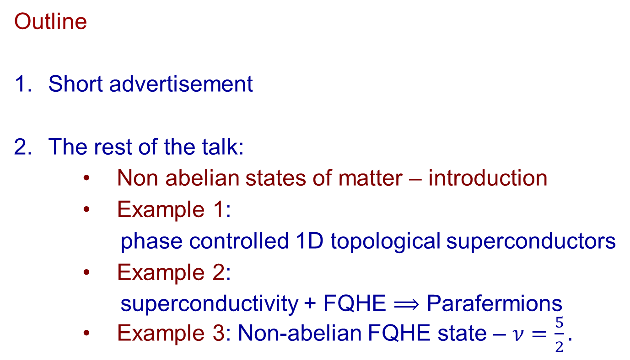
Outline
Short advertisement
The rest of the talk:
    Non abelian states of matter – introduction
    Example 1:
    phase controlled 1D topological superconductors
    Example 2:
    superconductivity + FQHE $⟹$ Parafermions
    Example 3: Non-abelian FQHE state – $ν=\frac{5}{2}.$

Slide 4

1. The Quantum Hall effect
2. Topological superconductivity
3. Topological universe on a graphene sheet
4. Topological insulators
5. Topological classification
6. Gapless topological phases
7. Material prediction
8. States of topological Order
9. Experimental tools
On EDX, CampusIL & Youtube tqm.course@Weizmann.ac.il
Search for Topological quantum matter Weizmann online

Slide 5
Non abelian states of matter - Introduction

Slide 6

Non-abelian state of matter:
Think of a two dimensional electronic system
  A gapped spectrum
  A degenerate ground state (protected degeneracy)
E
Energy gap
Degenerate ground state

Slide 7
The degeneracy should be topologically protected -
The Hamiltonian:
0
0
0
Non-zero
Non-zero
0
Non-zero, but gapped
Non-zero, but gapped
Virtual transitions to excited states induce only exponentially small splitting between ground states, due to the energy gap

Slide 8
Introducing dynamics into the state by interchanging “quasi-particles”
Electrons
quasi-particles
A ground state:
Energy gap
ground states
position of
quasi-particles
…..
Interchange implements a unitary transformation within this subspace

Slide 9
Up to a global phase, the unitary transformation depends only on the topology of the trajectory
1
2
2
3
3
1
As robust as an electronic system gets…

Slide 10
Topological quantum computation (Kitaev 1997-2003)
Subspace of degenerate ground states, separated by an energy gap from the continuum of excited states.
Unitary transformations within this subspace are defined by the topology of braiding trajectories
- immunity to errors
Local operators do not couple between ground states
– immunity to decoherence
Examples to non-abelian systems:
Topologically protected localized zero energy excitations in superconductors, a.k.a. Majorana fermions
Certain quantum Hall states (Moore-Read-Rezayi)

Slide 11
The level of understanding we would like to aspire to:
Bloch: To get a band insulator, we put electrons in a periodic potential and have an even number of electrons per unit cell
BCS: To get a super-conductor, take electrons in a partially filled band and induce attractive interaction through phonons
Future theory:
To get non-abelian state of matter in an electronic system ………………………………………………

Slide 12
Example number 1 –
Phase controlled 1D topological superconductor
(in particular, a new set-up)

Slide 13
One dimensional superconductors are
1. Exciting – localized Majorana zero modes, topological protection, non-abelian statistics, topological quantum information processing
2. Based on a straightforward theory
3. Are harder to realize, control and explore than they could have been
Perhaps we have not yet found the best experimental set-up…

Slide 14
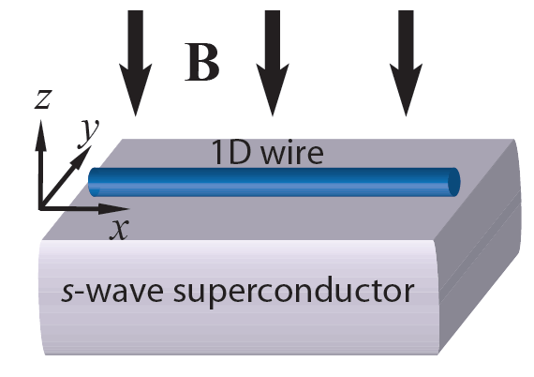
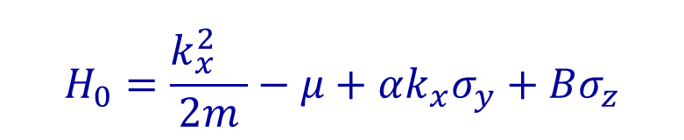



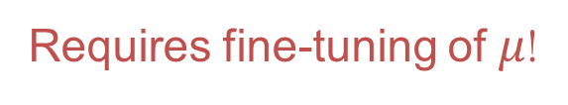






Topological Superconductivity in Nanowires
Quantum wire with spin-orbit coupling and Zeeman field:
$$H_{0}=\frac{{k_{x}^{2}}^{}}{2m}−μ+αk_{x}σ_{y}+Bσ_{z}$$
$$γ$$
$$γ$$
$$E$$
$$↓$$
$$↑$$
$$Δ$$
$$2B$$
$$μ$$
Lutchyn et al. PRL 2010
Oreg et al. PRL 2010
$$k_{x}$$
figure taken from
Alicea, Rep. Prog. Phys. (2012)
Requires fine-tuning of $μ$!

Slide 15
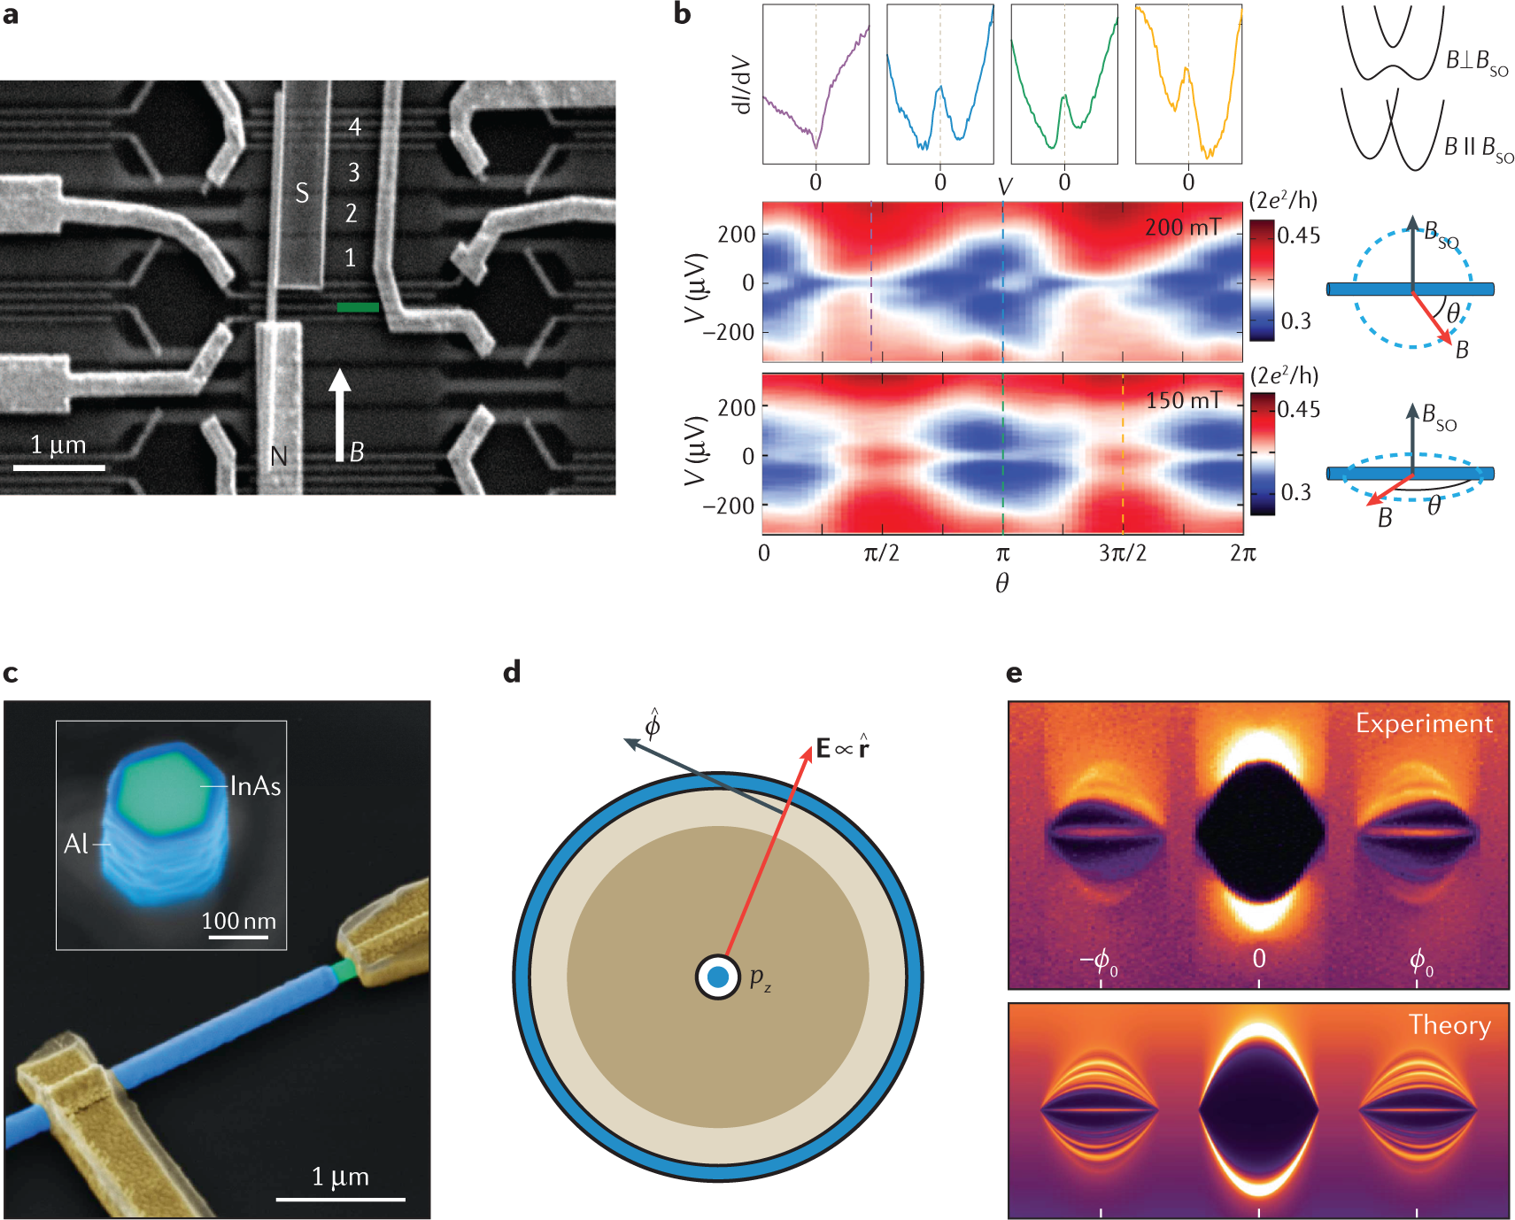
Mourik, V. et al. Science 336, 1003–1007 (2012)
Vaitiekenas, S. et al. Science 367, eaav3392 (2020)

Slide 16
(Aghaee et al., 2022)

Slide 17
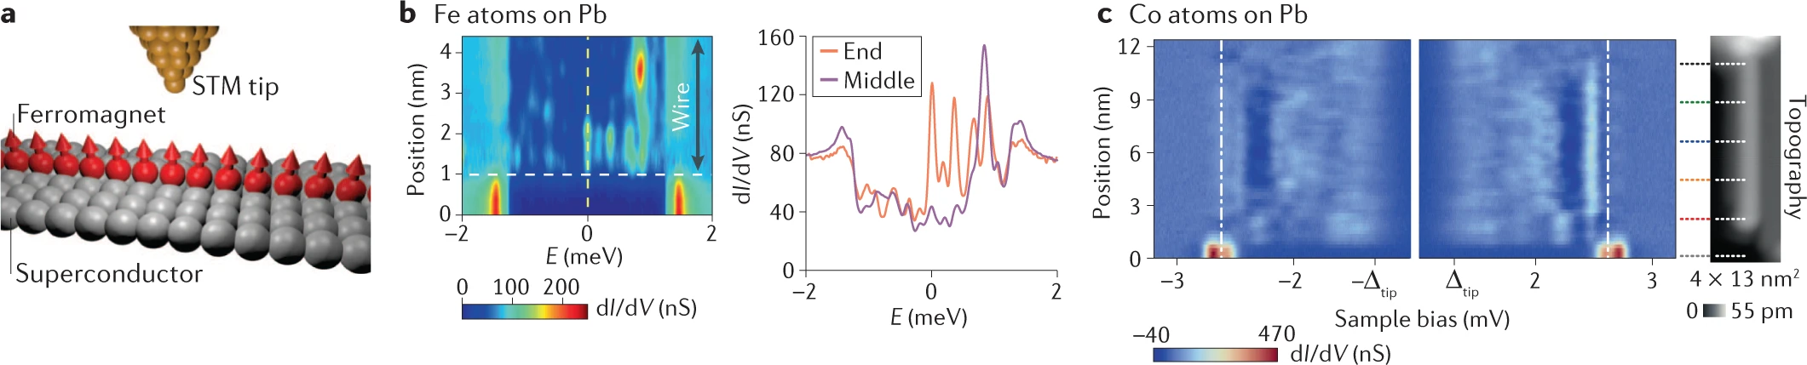
Nadj-Perge, S. et al. Science 346, 602–607 (2014)
Feldman, B. E. et al. Nat. Phys. 13, 286–291 (2017)
Ruby, M., et al., Nano Lett. 17, 4473–4477 (2017).
Difficulties:
Uneasy coexistence of superconductivity and magnetic field
Uneasy coexistence of gating and superconductivity
Disorder

Slide 18
Introducing a new knob – the superconducting phase

Slide 19
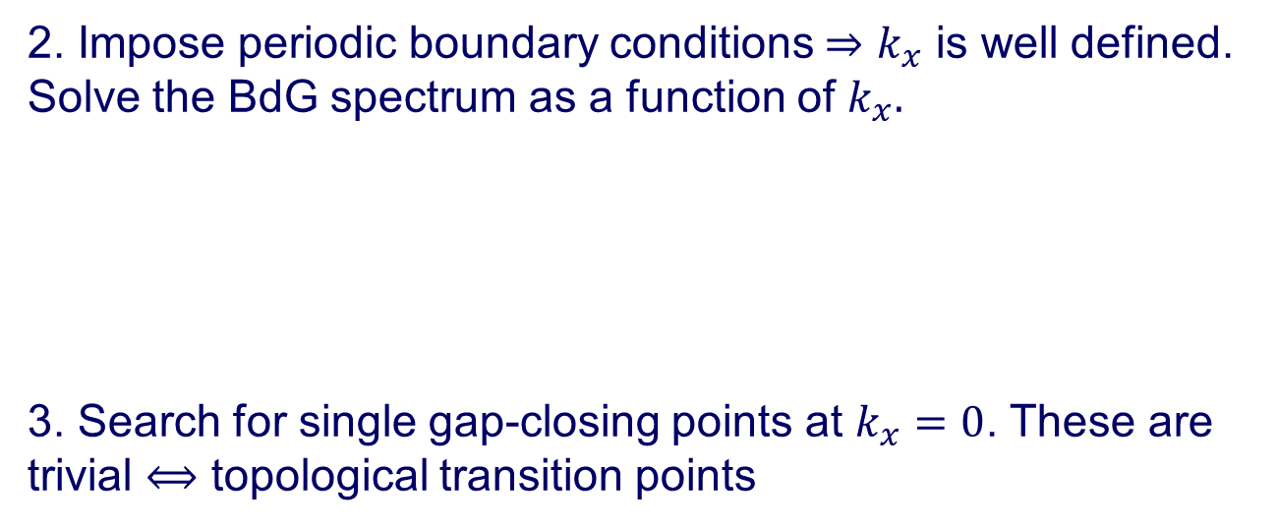





The rules of the game:
1. Introduce a 1D superconducting system
$$Δe^{iφ/2}$$
$$Δe^{iφ/2}$$
2 DEG
2 DEG
$$\vec{B}$$
$$Δe^{−iφ/2}$$
$$Δe^{−iφ/2}$$
2. Impose periodic boundary conditions $⇒k_{x}$ is well defined. Solve the BdG spectrum as a function of $k_{x}.$
3. Search for single gap-closing points at $k_{x}=0$. These are trivial $⟺$ topological transition points
Spin symmetry must be broken!

Slide 20
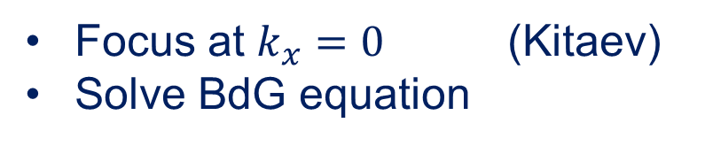
How do you recognize a 1D topological SC (theoretical level)
Focus at $k_{x}=0$ (Kitaev)
Solve BdG equation
Energy
Single gap closing signifies a topological phase transition
parameter

Slide 21
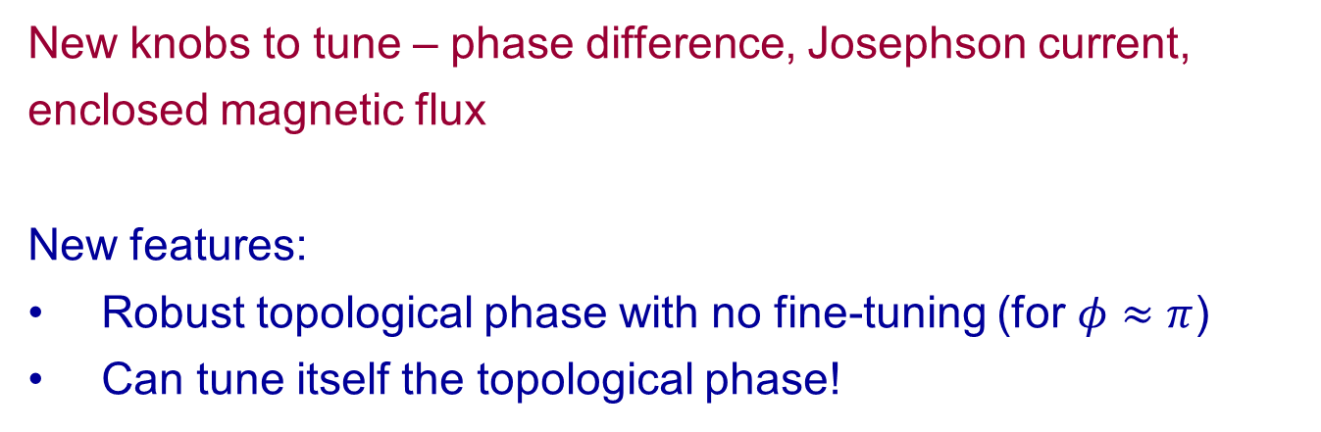



1D topological superconductor in a 2D setting
(Pientka, Keselman, Yacoby, Berg, Stern, Halperin) (Hell et al. )
$$Δe^{iφ/2}$$
Ingredients:
1D
Spin-orbit
Superconductivity
Magnetic field
2 DEG
$$γ$$
$$\vec{B}$$
$$γ$$
$$W$$
$$Δe^{−iφ/2}$$
New knobs to tune – phase difference, Josephson current, enclosed magnetic flux
New features:
Robust topological phase with no fine-tuning (for $φ≈π$)
Can tune itself the topological phase!
Notes:
You are probably wondering what do 2DEGs have to do with 1D TSC..
But lets look at the setup realized in experiments again, we have an electronic system with spin-orbit, proximity coupled to a superconductor (or two superconductors), note that the junction defines a 1D system. Now we only need Zeeman field and we can have Majoranas.
W does not need to be particularly narrow as we will see later on..

Slide 22
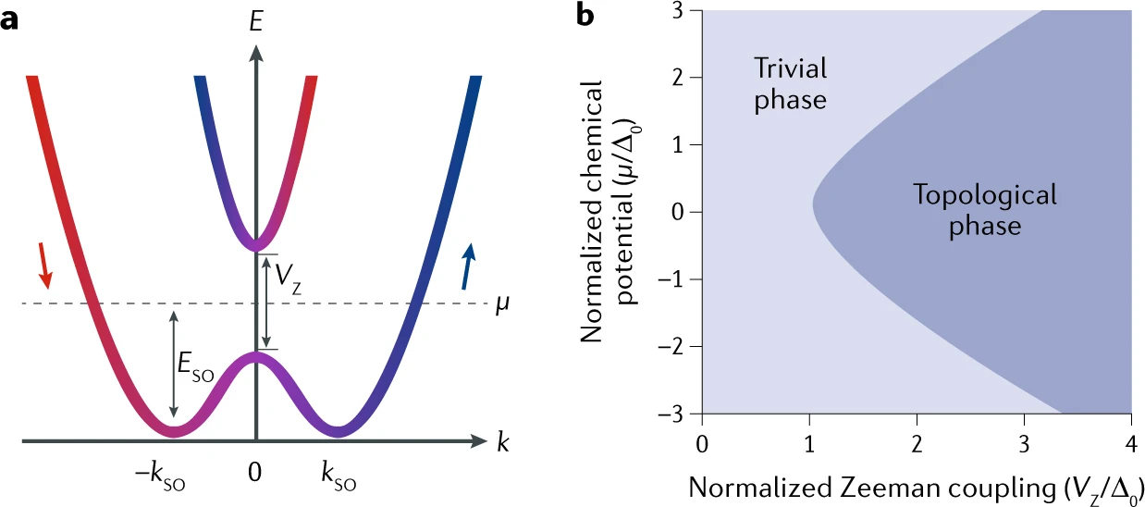
Robust topological phase with no fine-tuning (for $φ≈π$)
Phase difference
Zeeman energy * traversal time
Only weak dependence on the chemical potential
(Spin orbit energy >> Zeeman energy, wide superconductors)

Slide 23
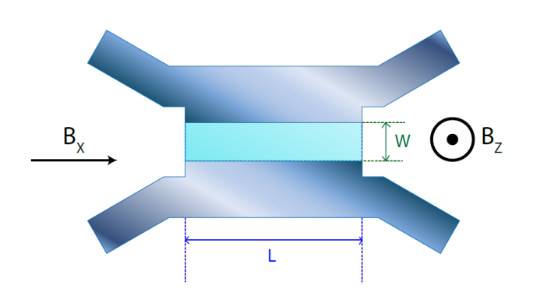
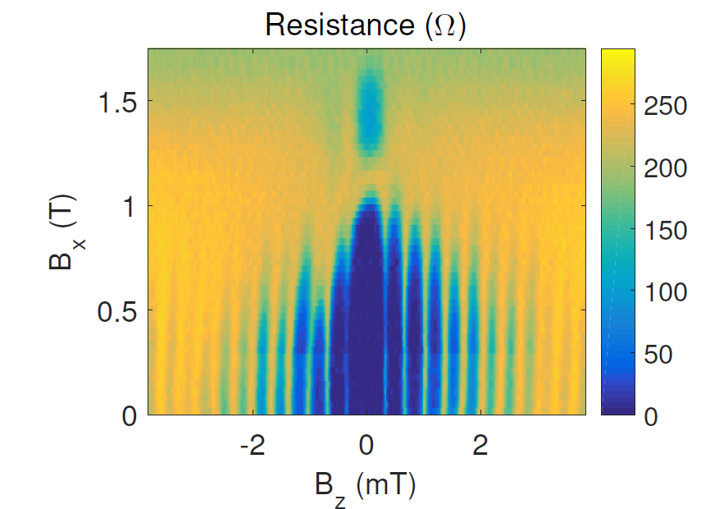
First order phase transition between trivial and topological state
– the system self tunes to the topological regime
The phase difference at the ground state:
Hart et al. arXiv,1509.02940 (2015)
The transition coincides with a minimum of the critical current.
Notes:
We can verify this using TB. In the BG this is the PD as function of phi and B, the cyan area is topological, the red curves correspond to phi in the GS as B is varied and below is the critical current, normalized -> jump in phi, min in Ic
Interestingly, the minima become deeper as T increased, there is still jump in phi for low enough T.
Let me now go back to experiments on this setups and specifically to the one from Amir’s group..
High differential resistance corresponds to lower critical current

Slide 24

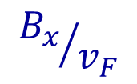










Setup and Model
$$Δe^{iφ/2}$$
2 DEG
$$\vec{B}$$
$$W$$
$$y$$
$$Δe^{−iφ/2}$$
$$x$$
$$B_{x}≪αk_{F}$$
$${B_{x}}/{v_{F}}$$
Hamiltonian in the normal region:
$$H_{0}=\frac{{k_{x}^{}}^{2}+k_{y}^{2}}{2m}−μ+α\left(k_{x}σ_{y}−k_{y}σ_{x}\right)+B_{x}σ_{x}$$
$$H_{0}=\frac{{k_{x}^{}}^{2}−∂_{y}^{2}}{2m}−μ+α\left(k_{x}σ_{y}+i∂_{y}σ_{x}\right)+B_{x}σ_{x}$$
$$k_{y}$$
$$k_{x}$$
Notes:
More explicitly, lets write the Hamiltonian and first consider only the normal region –
mu is…, alpha is.., Zeeman field is in-plane along x, and we assume it is small compared to SO, so it does not polarize the electrons on the FS
The FSs are two concentric circles with opposite chiralities. Bx shifts the two FS along y.
Note that B does not open a gap in the system (in contras to the wires).
We assume the junction is infinite along x and therefore kx, the momentum along x, is conserved.
I will assume Zeeman field is nonzero only in the junction, although the topological phase exists also for a uniform Zeeman field.

Slide 25



We are looking for states within the gap, bound between the two superconductors
$$Δe^{iφ/2}$$
2 DEG
$$\vec{B}$$
$$W$$
$$y$$
$$Δe^{−iφ/2}$$
$$x$$
Almost the particle in the box problem, except the boundary conditions - Andreev processes
e
e
h

Slide 26

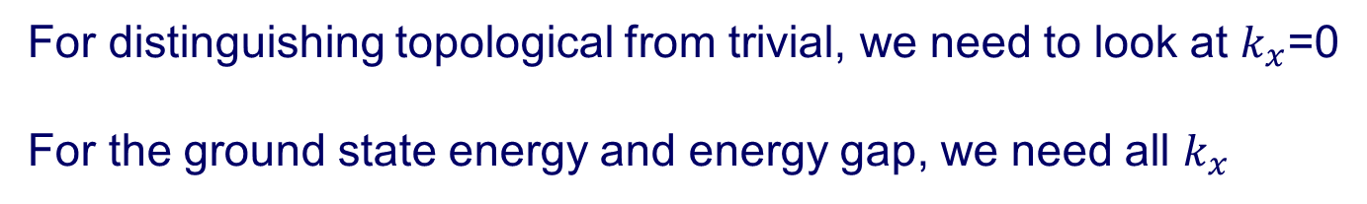
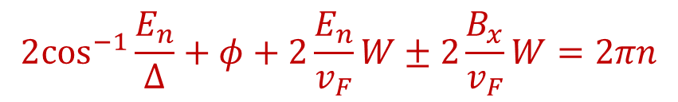

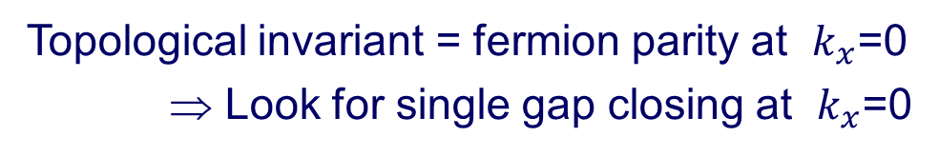


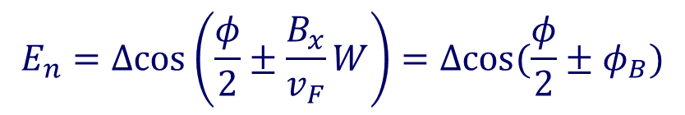

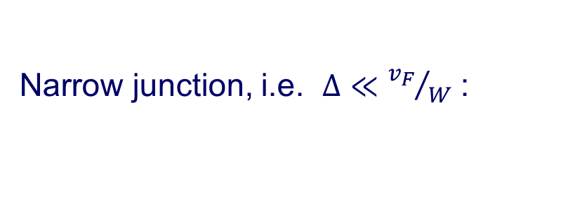

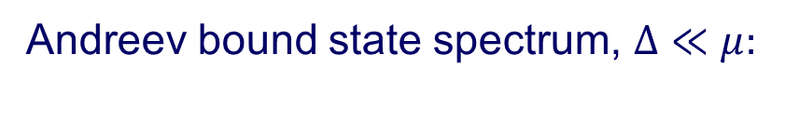
For distinguishing topological from trivial, we need to look at $k_{x}$=0
For the ground state energy and energy gap, we need all $k_{x}$
Topological invariant = fermion parity at $k_{x}$=0
⇒ Look for single gap closing at $k_{x}$=0
Kitaev (2001)
$$e_{↑}$$
Andreev bound state spectrum, $Δ≪μ:$
$$Δe^{−iφ/2}$$
$$Δe^{iφ/2}$$
$$h_{↓}$$
$$y$$
$$2\cos^{−1}{\frac{E_{n}}{Δ}+φ+2\frac{E_{n}}{v_{F}}W±2\frac{B_{x}}{v_{F}}W=2πn}$$
$$W$$
phase acquired upon Andreev reflection
phase acquired upon traversing the junction
$$E_{n}=Δcos\left(\frac{φ}{2}±\frac{B_{x}}{v_{F}}W\right)=Δcos⁡(\frac{φ}{2}±φ_{B})$$
Narrow junction, i.e. $Δ≪{v_{F}}/W$ :
Notes:
Miraculously, as was shown by Kitaev, to understand if the system is in the topological phase we only need to look at kx=0. It turns out that the topological invariant is the fermion parity at kx=0. Therefore, topological phase transitions are determined by gap closing at kx=0.
Even more miraculously, SO can be gauged out
Using Andreev approximation… and assuming no normal backscattering at the normal-superconducting interface

Slide 27
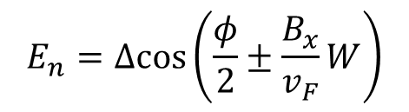



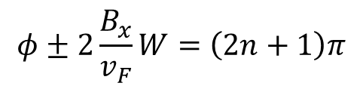



Phase Diagram
$k_{x}$=0 bound states:
Gap closing lines (for any $W$):
$$E_{n}=Δcos\left(\frac{φ}{2}±\frac{B_{x}}{v_{F}}W\right)$$
$$φ±2\frac{B_{x}}{v_{F}}W=\left(2n+1\right)π$$
$B_{x}$=0
$$E_{n}$$
2π φ
Topological
Trivial
$$\frac{B_{x}W}{v_{F}}$$
$0 2π$ $∅$
π/2 π 3 π/2
State is doubly degenerate!
Insensitive to $μ$!
Notes:
For B=0, we obtained the well known ABS spectrum. The crossing is degenerate, gap closings come in pairs, and we therefore can’t obtain the topological phase. To obtain the topological phase we need to split this degeneracy. B does exactly that!
The gap closing lines (En=0 solution) are given (in fact for any W) by.. resulting in the following diamond-shaped phase diagram as function of the phase difference and Zeeman field.
At phi=pi the system is always topological!
Independent of B and mu!
Dependence on mu only through v_F but no oscillations as function of mu
We assumed no normal backscattering. As normal backscattering is increased, the bound states will have less dependence on phi, the phase boundaries will be less dependent on phi.. In the limit of large normal reflection we recover the wire

Slide 28
Majorana end states

Slide 29

What if the superconductors are narrow?
(with Setiawan Wenming and Erez Berg, 2019)
Width of superconductor $≪$ induced coherence length $hv_{F}/Δ$.
Normal reflections from the interface with the vacuum $⇒$ minimum field required for topological superconductivity.
Small $Δ$ implies $⇒$ intra-subband pairing only.
$⇒$
  the pairing amplitude is averaged $Δcos\left(\frac{φ}{2}\right)$.
  Right-left symmetry leads to BDI symmetry
(protects topological transitions at $φ=π.$) (in wires: Sau et al., 2012)

Slide 30
Experiments – Nichele - Marcus group (NBI)
Measuring the tunneling density of states
at the end of the junction

Slide 31
Improved set-up
(Banerjee et al., 2022)

Slide 32
Experiments – Yacoby group (Harvard)
Measuring the tunneling density of states
at the end of the junction

Slide 33
Experiments – Goswami group (Delft)
Measurement of the recovery of the critical current with increasing parallel magnetic field

Slide 34



Eliminating the magnetic field altogether
(Lesser, Oreg, Stern, 2022)
$$Δe^{−iθ}$$
$$Δ^{′}e^{iφ}$$
$$Δe^{iθ}$$
SNSNS junction – two phase differences
Different velocities of the two spin branches in the two superconductors

Slide 35
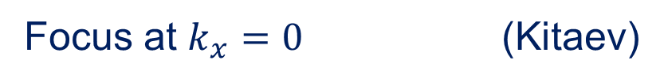
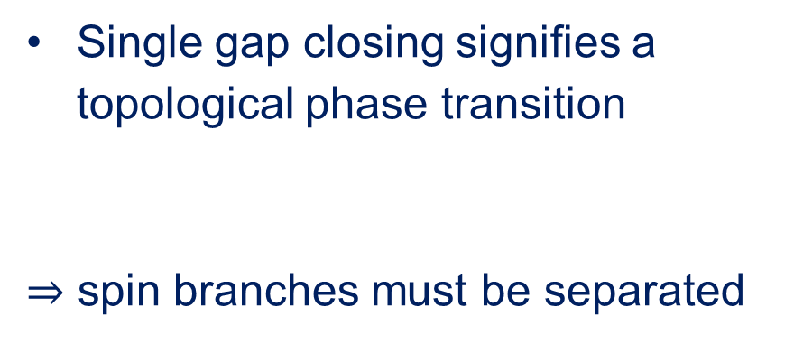
How do you recognize a 1D topological SC (theoretical level)
Focus at $k_{x}=0$ (Kitaev)
Energy
Single gap closing signifies a topological phase transition
$⇒$ spin branches must be separated
parameter

Slide 36
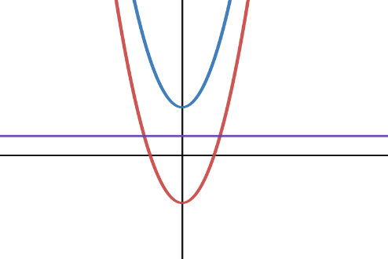
One dimension – two spin branches in each direction.
Several ways to separate them:
In real space –
In momentum space –
In energy –
Fu & Kane
Oreg & Lutchyn
Now – in velocities
Kitaev

Slide 37


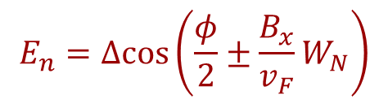
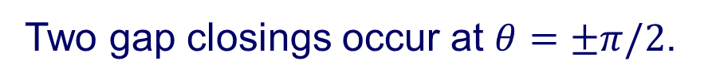
Start from -
$$Δe^{−iθ}$$
$$Δe^{iθ}$$
S N S
Two gap closings occur at $θ=±π/2$.
May be separated by the application of a Zeeman parallel magnetic field. (Hell et al., Pientka et al.)
$$E_{n}=Δcos\left(\frac{φ}{2}±\frac{B_{x}}{v_{F}}W_{N}\right)$$
Experiments by Ren et al. Fornieri et al., Banergee et al.

Slide 38

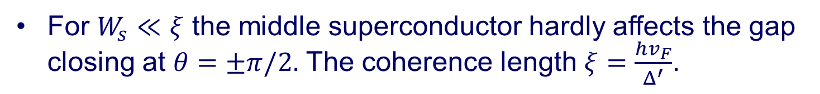

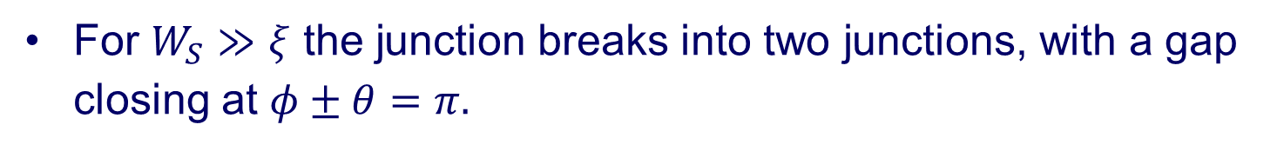
Instead of the magnetic field -
$$Δe^{−iθ}$$
$$Δe^{iθ}$$
S N S
Add a third superconductor in the middle with $Δ′e^{iφ}$and width $W_{s}$.
For $W_{s}≪ξ$ the middle superconductor hardly affects the gap closing at $θ=±π/2.$ The coherence length $ξ=\frac{hv_{F}}{Δ^{′}}$.
For $W_{S}≫ξ$ the junction breaks into two junctions, with a gap closing at $φ±θ=π.$
We need a spin dependent $v_{F}.$

Slide 39
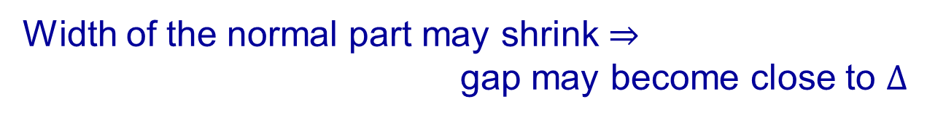



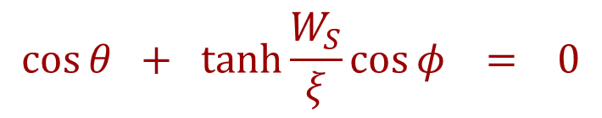
$$Δe^{−iθ}$$
$$Δ^{′}e^{iφ}$$
$$Δe^{iθ}$$
$$\cos{θ + \tanh{\frac{W_{S}}{ξ}}\cos{φ} = 0}$$
The gap closes at
Width of the normal part may shrink $⇒$
gap may become close to $Δ$

Slide 40




$$\cos{θ + \tanh{\frac{W_{S}}{ξ}}\cos{φ} = 0}$$
$$θ$$
$$φ$$
$$−θ$$
The origin must be within the triangle for topological superconductivity

Slide 41
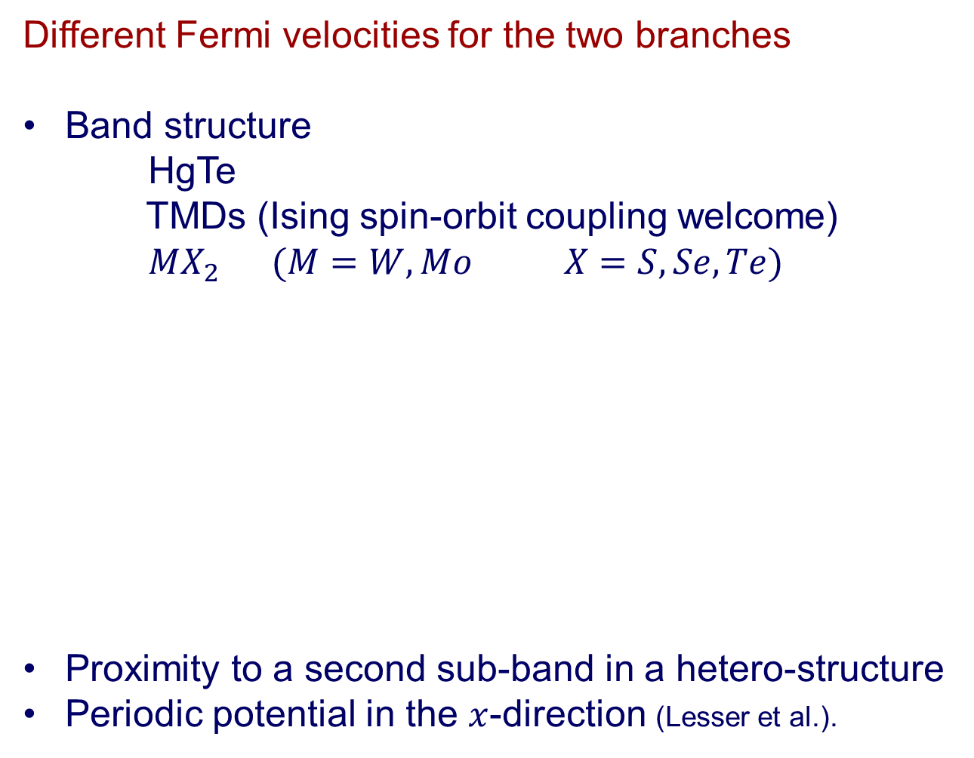
Different Fermi velocities for the two branches
Band structure
HgTe
TMDs (Ising spin-orbit coupling welcome)
$MX_{2} (M=W, Mo X=S,Se,Te)$
Proximity to a second sub-band in a hetero-structure
Periodic potential in the $x$-direction (Lesser et al.).

Slide 42
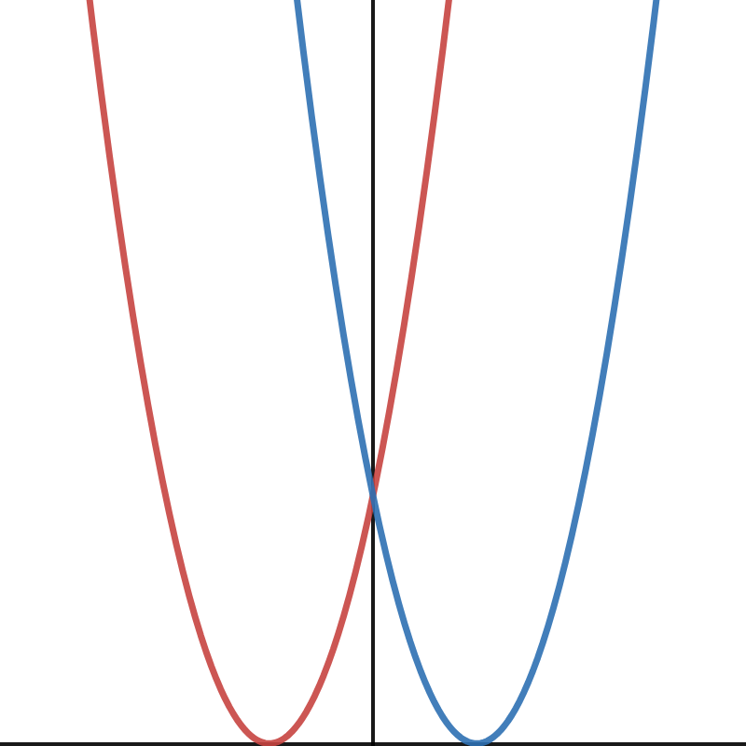
Unequal Fermi velocities –
presumption of innocence or presumption of guilt?
The Rashba bias
Exact for a 1D ring with nearest neighbor hopping only
SOC acts like spin-dependent flux (Meir et al., 1989)

Slide 43
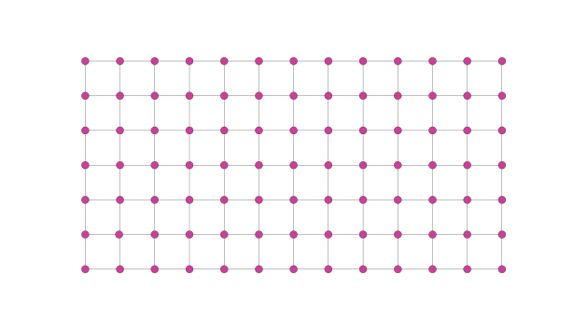

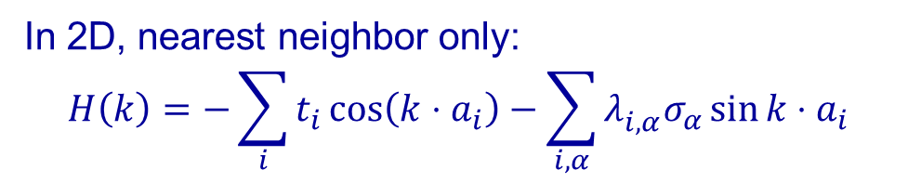

$$Δe^{−iθ}$$
$$Δe^{iθ}$$
In 2D, nearest neighbor only:
$$H\left(k\right)=−\sum_{i}{t_{i}\cos\left(k⋅a_{i}\right)−\sum_{i,α}{λ_{i,α}^{}σ_{α}\sin{k⋅a_{i}}}}$$
$k_{x}=0$ the problem becomes 1D, with longer range hopping

Slide 44
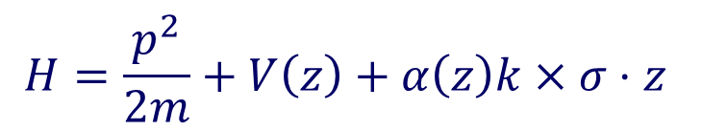
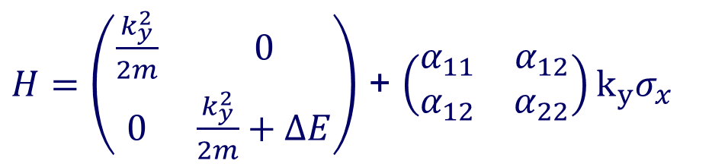

Hetero-structures
$$H=\frac{p^{2}}{2m}+V\left(z\right)+α\left(z\right)k×σ⋅z$$
$H=\left(\begin{matrix}\frac{k_{y}^{2}}{2m} & 0 \\ 0 & \frac{k_{y}^{2}}{2m}+ΔE\end{matrix}\right)$ + $\left(\begin{matrix}α_{11} & α_{12} \\ α_{12} & α_{22}\end{matrix}\right)k_{y}σ_{x}$
$$α_{ij}=∫dzχ_{i}\left(z\right)α\left(z\right)χ_{j}\left(z\right)$$

Slide 45
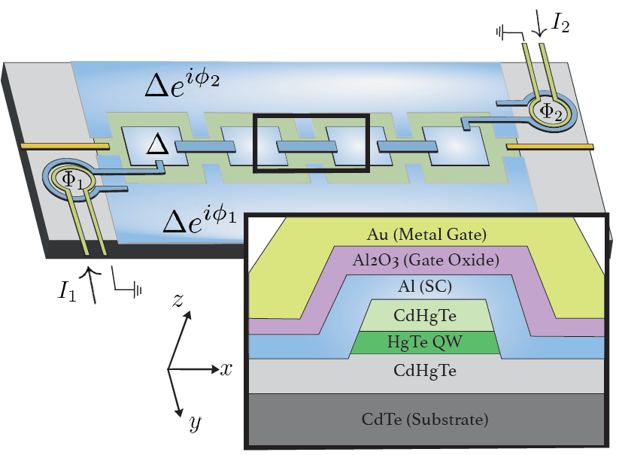
Periodicity in the $x$-direction (Lesser et al.)

Slide 46
The effect of disorder on the localization of the zero modes
With Arbel Haim (Cal-Tech)

Slide 47

Numerically -
For weak disorder, Majoranas get (significantly) better localized.
In contrast to 1D p-wave superconductors.
Why –
1. Identify the culprit – large $k$ gap
2. The effect of disorder on that gap – combination of selection rules and pairing phases.

Slide 48









Spectrum of excitations in the topological phase
(a)
(b)
(c)
$$φ=0,B_{x}=0$$
$$φ=0.57π,B_{x}=0.28$$
$φ=π,B_{x}=0.$5
$$Δe^{iφ/2}$$
2 DEG
$$\vec{B}$$
$$W$$
$$y$$
$$Δe^{−iφ/2}$$
$$x$$
Smallest gap at the two Fermi momenta
Notes:
We verify this with a TB calculation…
Let me get back to the question of the gap in the system, and you can already see from these figures that when the gap is maximal it is dictated by the gap at kFs.

Slide 49

Think about the spectrum as coming from pairing of several modes
Effect of disorder - perturbative calculation:
Localization length - $\frac{hv_{F}}{Δ_{eff}}$
$Δ_{eff, m}≈Δ_{m}+\sum_{n≠m}{\frac{1}{τ_{mn}}e^{i arg\left(Δ_{n}\right)+iα_{mn}}}$ $\frac{1}{τ_{mn}}=\frac{V_{mn}^{2}}{|v|}$

Slide 50


$$Δ_{eff, m}≈Δ_{m}+\sum_{n≠m}{{\left(\frac{1}{τ}\right)}_{mn}e^{i arg\left(Δ_{n}\right)}}$$
To be affected by a channel, need to be able to scatter into it
Once scattered into it, the phase of its pairing potential matters.
Particular cases:
Disorder scattering into the pairing partner – necessarily reduces $Δ_{eff}$ (phase difference of $π$).
  $$Δ_{m}c_{m}^{+}c_{−m}^{+} ⇒ Δ_{m}=−Δ_{−m}$$
Delocalizes Majorana modes in p-wave superconductors.

Slide 51
Different situation for s-wave superconductors
  Selection rule – disorder does not flip spin, so no scattering to pairing partner.
  No phase difference of pairing potentials.
  Disorder enhances localization

Slide 52


In our case, large $k$ behaves like s-wave, small $k$ behaves like p-wave
The small $k$determines topology, the large $k$ determines localization.
Magnetic impurities couple large-k pairing partners, and delocalize the Majorana modes

Slide 53
Summary:
Difficulties:
Uneasy coexistence of superconductivity and magnetic field
Uneasy coexistence of gating and superconductivity
Disorder
Solutions:
Replace the magnetic field by tuning of phases
Dependence on chemical potential is weak
Effects of disorder may be weakened

Slide 54
Manipulating and braiding the Majorana zero modes
With Erez Berg (WIS)

Slide 55
Outline
Short advertisement
The rest of the talk:
    Non abelian states of matter – introduction
    Example 1:
    phase controlled 1D topological superconductors
    Example 2:
    superconductivity + FQHE $⟹$ Parafermions
    Example 3: Non-abelian FQHE state – $ν=\frac{5}{2}.$

Slide 56

Example number 2:
Superconductivity + FQHE $⟹$ Parafermions
With Netanel Lindner, Erez Berg, Gil Refael
Related works by Barkeshli & Qi, Clarke, Shtengel & Alicea, Meng, Vaezi

Slide 57
Introduction to the classical and quantum Hall effect
Electrons in two dimensions
---------------------------------
I
B
+++++++++++++++
Classically,
Hall resistivity -
longitudinal resistivity - unchanged by B.

Slide 58

The quantum Hall effect
zero longitudinal resistivity
quantized Hall resistivity – a topological quantity
ν is an integer, or a fraction $\frac{p}{q}$ with q odd, or q even

Slide 59
The essential QHE aspects to remember:
Bulk energy gap
Chiral gapless edge modes
Fractionally charged quasi-particles

Slide 60

Non-abelian quantum Hall states (Read, Moore, Green, Rezayi…)
An offer made to the electrons, among many other phases that are offered (abelian quantum Hall states, charge density waves etc. etc.)
“Engineering” –
Can we make the electrons an offer they cannot refuse?
(P-C-B, The Godfather, 1972)

Slide 61
How to engineer a ground state degeneracy?
Take two counter-propagating edge modes.
(electrons)
(holes)
First we need an energy gap, which requires coupling right and left movers
There are two ways to gap the two edge modes:
Back-scattering
Coupling to a super-conductor (Fu & Kane)

Slide 62
Back-scattering opens a gap and makes the system insulating
Coupling to a super-conductor opens a gap and makes the system super-conducting
S.C
Look at the interface between the two mechanisms

Slide 63








Some technicalities - Effective Edge Model
Density:
Spin density:
Electron:
(charge 1, spin 1)
Laughlin q.p.:
(charge 1/m, spin 1/m)
Notes:
Thank you for the opportunity to present this work that we did recently. I'll be presenting two projects, one of which is summarized in this paper and the other still unpublished.

Slide 64

Alternate coupling (with some technicalities)
$\cos{2mφ }$ - coupling to a super-conductor
$\cos{2m }$Ө- coupling by back-scattering
The $2m$minima – degeneracy of the ground state
Notes:
Thank you for the opportunity to present this work that we did recently. I'll be presenting two projects, one of which is summarized in this paper and the other still unpublished.

Slide 65

At the interface between a super-conductor and an insulator – a zero energy mode:
An operator χ(r) localized near the interface, commutes with the Hamiltonian, takes the system from one ground state to another
Super-conducting segments, where charge is quantized in units of e/m, and the ground state energy is insensitive to the charge. Six possible value of the charge. Degeneracy $6^{N−1}.$

Slide 66




$$q_{2}$$
For m=1, χ is the Fu-Kane Majorana operator, reflecting even-odd degeneracy
The degeneracy cannot be removed by a local operator - it is topological
$$q_{1}$$
$$q_{n−1}$$
What do we mean by topologically protected transformations?
The initial state, e.g., $|q_{1},…q_{n−1}>$
should evolve into a final state in a way that does not depend on details of the Hamiltonian.
What would the Hamiltonian include?

Slide 67

Two dimensions – interchange of positions
One dimension?
How do you interchange two cars without taking them out of the lane?
Answer – tunneling! (Alicea et al.)

Slide 68






The way to get topological time evolution –
Introduce tunnel couplings in a way that keeps the degeneracy constant throughout the time evolution.
Then, evolution by non-abelian Berry phase
$U=\hat{T}exp\left(i\int{dl\left\langle Ψ_{i} | ∇Ψ_{j}\right\rangle }\right)$
with the integral along a trajectory in parameter space.
The allowed operations are not sufficient for universal TQC. (come back later…)
$$q_{2}$$
$$q_{1}$$
$$q_{3}$$
$$q_{4}$$
$$U=\exp\left(\frac{iπm}{2}Q^{2}\right)$$

Slide 69


Experiments – coupling FQHE to a super-conductor
Infinite finger
Gül et al. (PRX 12, 2022)
Partial success
Works better for FQHE than for IQHE!

Slide 70






First step – gap counter-propagating FQHE states by coupling them to a super-conductor
Fractional quasiparticles can:
  Traverse finger (if finite)
Electrons can:
  Andreev reflect - $Δ$
  Back-scatter - $Γ$
  Tunnel to vortices - $w$
$$e^{∗}$$
$$e^{∗}$$
$$e^{∗}$$
$$e$$
$$ν=1/m$$
Harder for electrons in the FQHE
Noam Schiller, Barak A. Katzir, Ady Stern, Erez Berg, Netanel H. Lindner, and Yuval Oreg (2022)

Slide 71

First step – gap counter-propagating FQHE states by coupling them to a super-conductor
Fractional quasiparticles can:
  Traverse finger (if finite)
Electrons can:
  Andreev reflect - $Δ$
  Back-scatter - $Γ$
  Tunnel to vortices - $w$
Harder for electrons in the FQHE
Noam Schiller, Barak A. Katzir, Ady Stern, Erez Berg, Netanel H. Lindner, and Yuval Oreg (2022)

Slide 72
Breaking a non-abelian state of matter
“Anyons live in two dimensions”
So, what gets broken in the one dimensional limit?
And – what survives?
With Yuval Oreg, Eran Sela, Eran Sagi, Bert Halperin

Slide 73
Can the distance between the localized zero modes, which may be made arbitrarily large, allow for protected fractional Majorana modes in 1D system?
For Majorana modes the answer is yes.
For fractional Majorana modes the answer must be No.
(Turner et al. Fidkowski et al.)
Notes:
73
Thank you for the opportunity to present this work that we did recently. I'll be presenting two projects, one of which is summarized in this paper and the other still unpublished.

Slide 74



Build the system step by step
1. Four edges, four charges – $q_{1}, q_{2}, q_{3}, q_{4}$
1
2
3
$$q_{1}+q_{3}=integer$$
$$q_{2}+q_{4}=integer$$
2. Gap the edges by coupling to a super-conductor. The coupling makes $q_{1}−q_{2}=0$ and $q_{1}+q_{2}$defined only modulo 2.
The three degenerate states are characterized by the fractional charge of $q_{1}+q_{2}.$ Possible values are $0, \frac{2}{3} , \frac{4}{3}$.

Slide 75



3. The quasi-1D limit, where tunneling takes place:
1
2
3
H= $\left(\begin{matrix}0 & 0 & 0 \\ 0 & 0 & 0 \\ 0 & 0 & 0\end{matrix}\right)$
We use the basis of charges $Q=0, \frac{2}{3} , \frac{4}{3}$.
In the quasi-1D limit, transitions between the charge states Q_{i} and Q_{f} are possible
Josephson Junction
$$\left(\begin{matrix}0 & V & V^{∗} \\ V^{∗} & 0 & V \\ V & V^{∗} & 0\end{matrix}\right)$$
where $V=te^{i2φ/3}$

Slide 76



The Hamiltonian for the narrow (quasi-1D) system is
$$\left(\begin{matrix}0 & V & V^{∗} \\ V^{∗} & 0 & V \\ V & V^{∗} & 0\end{matrix}\right)$$
where $V=te^{i2φ/3}$
The spectrum:
$6π$- periodic
Degeneracy points remain at φ=n$π$ .

Slide 77

4. Mix two types of couplings:
The degeneracy of the ground state is
$$6^{\# of super−conducting regions}$$
With the ground states characterized by the charges on each super-conductor (modulo 2, in units of 1/3)
Tunneling across the quasi-1D strip changes the charge by 2/3. So, the six states $0 \frac{1}{3} \frac{2}{3} 1 \frac{4}{3} \frac{5}{3}$
split to two,
superpositions of $0 \frac{2}{3} \frac{4}{3}$ and $1 \frac{5}{3} \frac{1}{3}$
Reduces to a Majorana degeneracy

Slide 78
So, only Majorana fermions survive the transition to one dimension.

Slide 79

Example number 3 –
A non-abelian quantum Hall state at $ν=5/2$

Slide 80
From electrons at ν=5/2 to non-abelian quasi-particles in four steps:
Read and Green (2000)
Step I:
A half filled Landau level on top of
two filled Landau levels
Step II:
the Chern-Simons transformation to
Spin polarized composite fermions at zero (average)
magnetic field
Step III: fermions at zero magnetic field pair into Cooper pairs
Spin polarization requires pairing of odd angular momentum
a p-wave super-conductor of composite fermions

Slide 81

Step IV: introducing quasi-particles into the super-conductor
- shifting the filling factor away from 5/2
The super-conductor is subject to a magnetic field and thus
accommodate vortices. The vortices, which are charged, are the
non-abelian quasi-particles.
For a single vortex – there is a zero energy mode at the vortex’ core
Kopnin, Salomaa (1991), Volovik (1999)

Slide 82
A zero energy solution is a spinor
g(r) is a localized function in the vortex core
A localized Majorana operator .
All γ’s anti-commute, and γ²=1.
A subspace of degenerate ground states, with the γ’s operating
in that subspace.
In particular, when a vortex i encircles a vortex j, the ground state is
multiplied by the operator γ_{i}γ_{j}
Nayak and Wilczek
Ivanov

Slide 83
Most direct experimental consequences:
Half quantized thermal Hall conductivity (“central charge” of the edge) - experiments by the Heiblum group
Interference – experiments by the Willett group

Slide 84

The way to measure the edge’s central charge – thermal Hall conductance
Hot
Cold
Note – conductance and not conductivity
The expected result - $(3+c_{M})\frac{π^{2}}{3h}T$

Slide 85


The measurement is very difficult
The scheme that works – control the heat current and measure the temperature difference (jezouin et al. 2013)
V
T₀
V_{M}
V_{M} T_{m}
..
Johnson noise
An electron thermometer

Slide 86
The measurement is very difficult
The scheme that works – control the heat current and measure the temperature difference (jezouin et al. 2013)
Charge conservation fixes V_{M}
Energy conservation fixes T_{m}
T₀
V_{M}
V_{M} T_{m}
V
Johnson noise
An electron thermometer

Slide 87
The power that comes in and the heat current that flows out are known
Need to measure the temperature T_{M}
The Majorana central charge is -1/2.
The first-ever observed non-abelian fractionalized state of matter.
But contradicts the numerical works.

Slide 88
Fabry-Perot interferometer: Stern et al., Bonderson et al. (2006)
ν=5/2
backscattering = |t_{left} + t_{right}|²
backscattering = |t_{right}|² + |t_{left}|²

Slide 89

Summary:
1D topological superconductors – Phase-only set-up.
Super-conductors + FQHE $⟹$ Parafermions
Non-abelian fractional quantum Hall states

