Slide 1
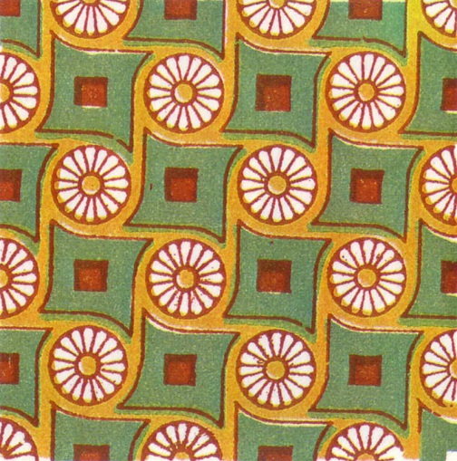
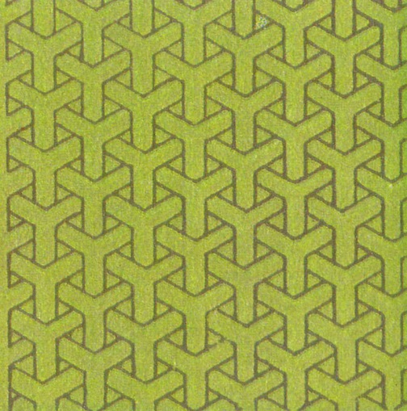
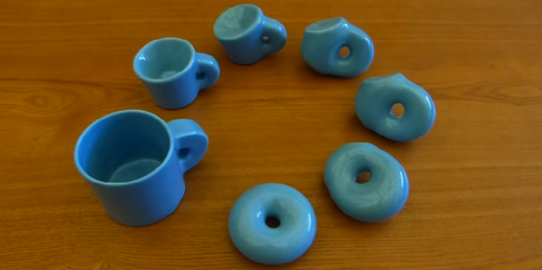
Organizing Principles for Understanding Matter
Symmetry
What operations leave a system
invariant?
Distinguish phases of matter
by symmetries
wallpaper group p4
wallpaper group p31m
Topology
What stays the same when a
system is deformed?
Distinguish topological phases
of matter
https://3dprint.com/
genus g = 1

Slide 2
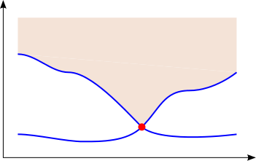
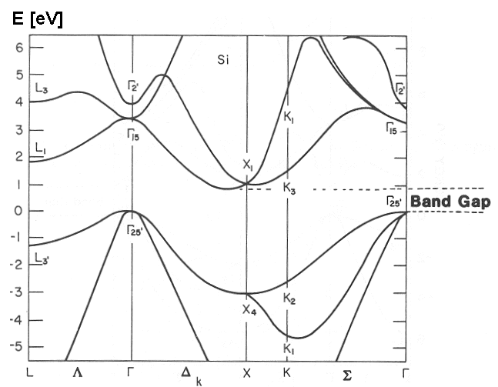
Topology and Quantum Phases
Topological Equivalence : Principle of Adiabatic Continuity
Many body energy spectrum
Quantum phases with an energy gap are topologically equivalent if they can be smoothly deformed into one another without closing the gap.
Topologically distinct phases are separated by quantum phase transition.
E
excited states
Gap
E_{G}
topological quantum
critical point
Ground state E₀
adiabatic deformation
Topological Band Theory
Single particle energy spectrum
Describe states that are adiabatically connected to non interacting fermions
Classify single particle Bloch band structures
E
E_{g} ~ 1 eV
k
Band Theory of Solids
e.g. Silicon

Slide 3
Topological Electronic Phases
Many examples of topological band phenomena
States adiabatically connected to independent electrons:
- Quantum Hall (Chern) insulators
- Topological insulators
- Weak topological insulators
- Topological crystalline insulators
- Topological (Fermi, Weyl and Dirac) semimetals …..
Many real materials
and experiments
Topological Superconductivity
Proximity induced topological superconductivity
Majorana bound states, quantum information
Tantalizing
experimental progress
Beyond Band Theory: Strongly correlated states
State with intrinsic topological order
- fractional quantum numbers
- topological ground state degeneracy
- quantum information
- Symmetry protected topological states
- Surface topological order ……
Much conceptual progress,
but theory is still far
from the real electrons

Slide 4
Topological Band Theory
I. Band Topology in One Dimension
- Berry phase and electric polarization
- Su Schrieffer Heeger model :
domain wall states and Jackiw Rebbi problem
- Thouless Charge Pump
II. Band Topology in Two Dimensions
- Integer quantum Hall effect
- TKNN invariant
- Edge States, chiral Dirac fermions
- Band inversion paradigm
III. Generalizations
- Higher dimensions
- Topological Defects
- Topological semimetals

Slide 5
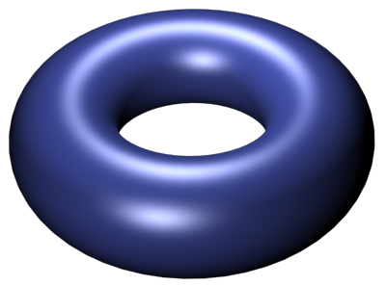
Band Theory of Solids
Bloch Theorem :
Lattice translation symmetry
Bloch Hamiltonian
k_{y}
π/a
k_{x}
=
−π/a
π/a
−π/a
BZ
Band Structure :
A mapping
E_{gap}
E
−π/a
k_{x}
π/a

Slide 6
Berry Phase
Phase ambiguity of quantum mechanical wave function
Berry connection : like a vector potential
Berry phase : change in phase on a closed loop C
Berry curvature :
Famous example : eigenstates of 2 level Hamiltonian
C
S

Slide 7
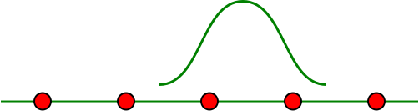
Topology in one dimension : Berry phase and electric polarization
1D insulator
Classical electric polarization :
-Q_{end}
+Q_{end}
Quantum polarization : a Berry phase
Bloch states are defined for periodic boundary conditions
Define localized Wannier States :
R
Wannier states associated with R are localized, but gauge dependent.
k
π/a
0
-π/a
BZ = 1D Brillouin Zone = S¹

Slide 8
Gauge invariance and intrinsic ambiguity of P
The end charge is not completely determined by the bulk
polarization P because integer charges can be added or
removed from the ends :
The Berry phase is gauge invariant under continuous gauge transformations,
but is not gauge invariant under “large” gauge transformations.
when
with
Changes in P, due to adiabatic variation are well defined and gauge invariant
λ
1
C
S
0
k
gauge invariant Berry curvature
-π/a
π/a

Slide 9
Su Schrieffer Heeger Model
model for polyacetylene
simplest “two band” model
E(k)
Gap 4|δt|
B,i
k
A,i
A,i+1
a
−π/a
π/a
Peierls’ instability → δt
d_{y}
d(k)
δt>0 : Berry phase 0
P = 0
d_{x}
d_{y}
d(k)
δt<0 : Berry phase π
P = e/2
d_{x}
Provided symmetry requires d_{z}(k)=0, the states with δt>0 and δt<0 are distinguished by
an integer winding number. Without extra symmetry, all 1D band structures are
topologically equivalent.

Slide 10
Symmetries of the SSH model
“Chiral” Symmetry :
Artificial symmetry of polyacetylene. Consequence
of bipartite lattice with only A-B hopping:
Requires d_{z}(k)=0 : integer winding number
Leads to particle-hole symmetric spectrum:
Reflection Symmetry :
Real symmetry of polyacetylene.
Allows d_{z}(k)≠0, but constrains d_{x}(-k)= d_{x}(k), d_{y,z}(-k)= -d_{y,z}(k)
No p-h symmetry, but polarization is quantized: Z₂ invariant
P = 0 or e/2 mod e

Slide 11
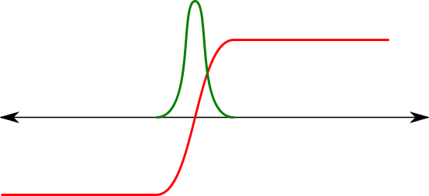
Topological Boundary Modes
Boundary between
topologically distinct insulators
Topological boundary
modes
Su Schrieffer Heeger Model (1979)
A
B
Polyacetalene (CH)_{n}
Jackiw Rebbi Model (1976)
ψ₀(x)
m(x)
chiral symmetry:
Single Particle Spectrum:
E
Topological zero energy
bound state
0
Many body ground state:
Charge fractionalization:
Splitting the indivisible
A
e/2
B
e/2
A

Slide 12
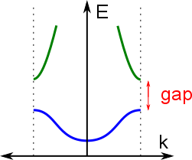
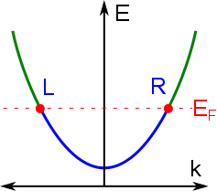
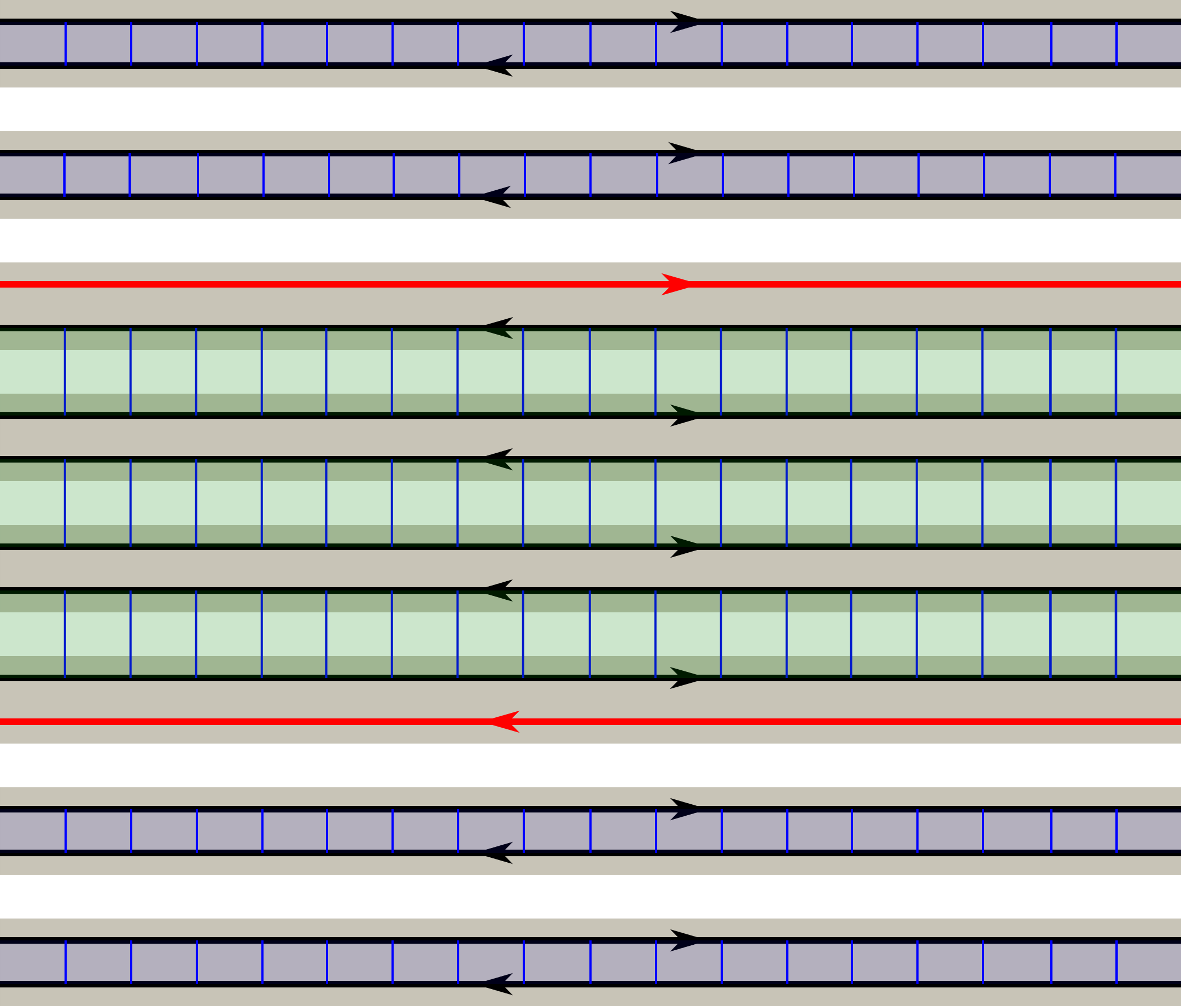
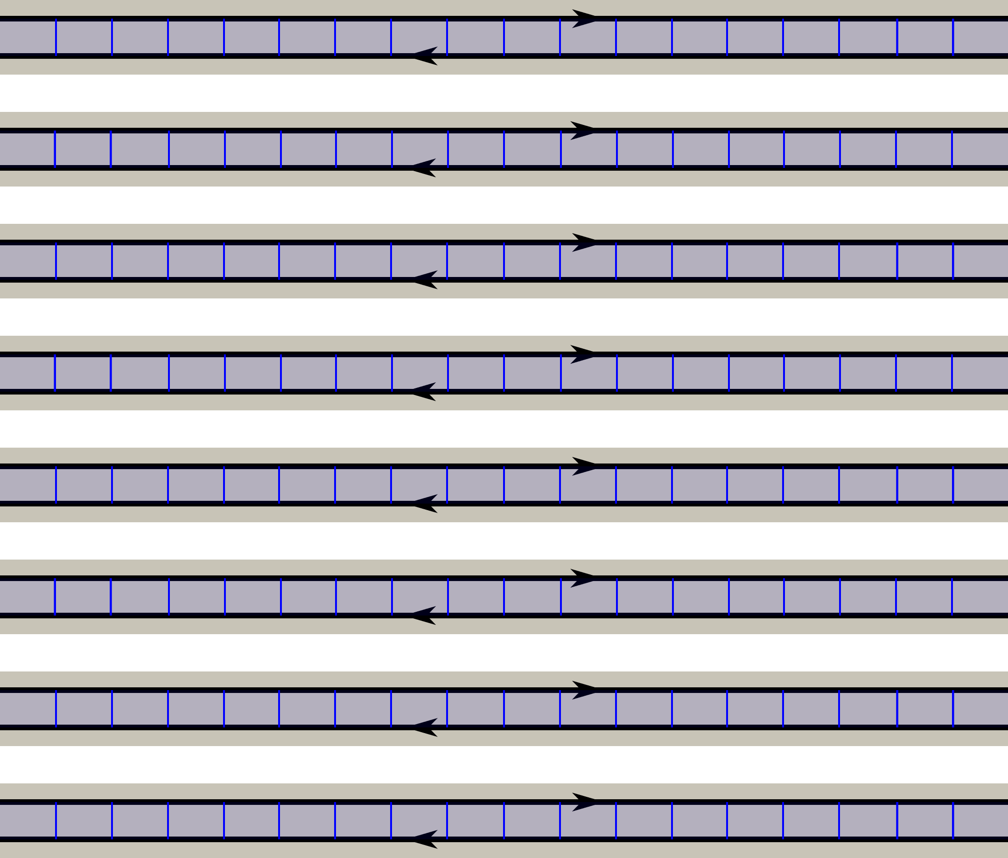
1D electrical conductor
Low energy excitations:
Right/Left moving “chiral fermions”
Localized by commensurate periodic
potential or disorder.
R
L
Split the 1D chiral modes in a 2D insulator:
Trivial Insulator
separated
chiral
boundary
modes
Topological “Chern” insulator
aka quantum Hall state
Trivial Insulator

Slide 13
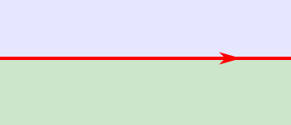
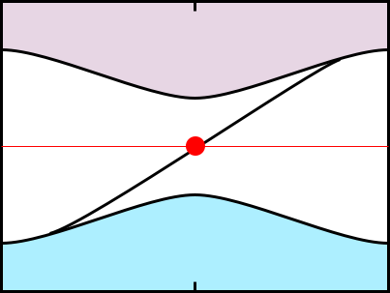

Chiral Edge States
Single-particle edge spectrum :
one-way propagating single particle states
E
conduction band
Insulator
E_{F}
Quantum Hall
State
valence band
−π/a
0
k_{x}
π/a
Many-body edge spectrum : “chiral Fermi liquid”
Free Dirac fermion conformal field theory
Quantized electrical conductance
Quantized thermal conductance:
Chiral Anomaly : In presence of electric field the edge charge density not conserved
chiral central
charge

Slide 14
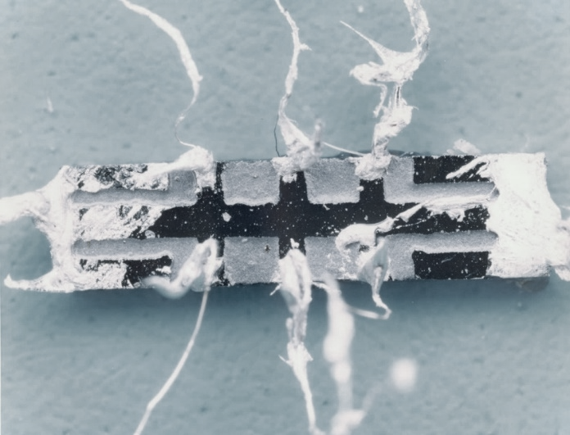
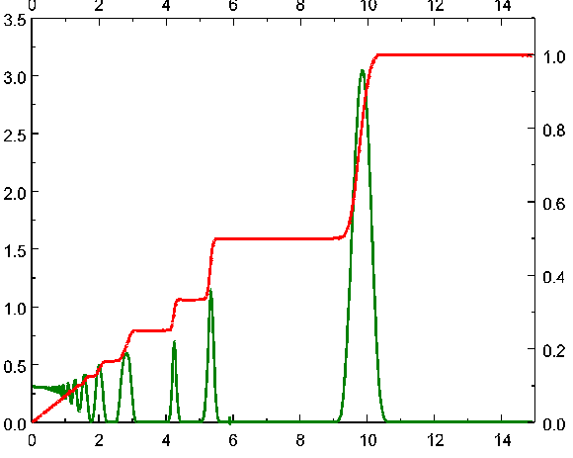
Quantized Hall Effect
2D electrons in magnetic field
E
Stormer, Tsui, Gossard 1981
Quantized Hall
conductance
Quantized thermal
Hall conductance
von Klitzing et al. ‘1980
ρ_{xy} = 1/σ_{xy}
Banerjee, Heiblum, et al. 2017
ρ_{xx}
n = Integer to 10⁻⁹

Slide 15
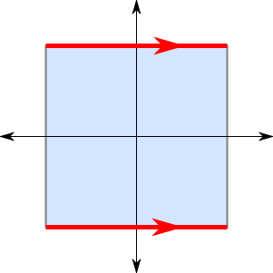

Topology in 2 Dimensions: Chern number (aka TKNN Invariant)
Thouless, Kohmoto,
Nightingale and den Nijs 82
For 2D band structure, define
π/a
k_{y}
BZ
C₁
k_{x}
−π/a
π/a
=
C₂
−π/a
Physical meaning: Quantized Hall conductivity
Laughlin argument: Thread flux ΔΦ = h/e
(Faraday’s law)
E
I
ΔΦ
-ne
ne
Thouless pump: Cylinder with circumference 1 lattice constant (a)
Φ plays role of k_{y}
Alternative calculation: compute σ_{xy} via Kubo formula

Slide 16
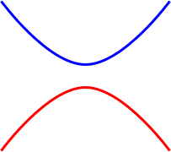
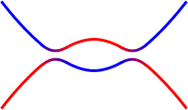
Realizing a Chern Insulator
Quantized Hall effect without Landau levels
Haldane model
Band Inversion Paradigm
k
E_{g}
Chern Band
C=1
conduction
band
E
E
valence
band
k
k
inverted
topological insulator
trivial insulator

Slide 17
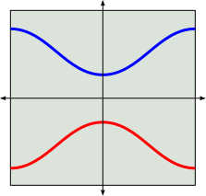


E
Lattice model for Chern insulator
conduction
band τ_{z} = +1
s
k
$$−\frac{π}{a}$$
$$\frac{π}{a}$$
valence
band τ_{z} = -1
p+ip
Square lattice model with inversion of bands with s and p_{x}+ip_{y} symmetry near Γ
d_{x}
d(k)
|ΔE_{sp}| > 4t : Uninverted
Trivial Insulator
d_{z}
Chern number 0
d_{y}
d_{x}
d(k)
|ΔE_{sp}| < 4t : Inverted
Chern Insulator
d_{z}
Chern number 1
d_{y}
Regularized continuum model for Chern insulator
m = 4t₀-ΔE_{sp}
a = t₀ a
v = 2t_{sp} a
Inverted near k=0 for m<0. Uninverted for $k→∞$

Slide 18
Edge States
Gapless states at the interface between topologically distinct phases
IQHE state
n=1
Vacuum
n=0
n=1
m = −m₀
n=0
m = +m₀
y
x
Edge states ~ skipping orbits
Lead to quantized transport
m>0
Domain wall
bound state ψ₀
E_{gap}
m<0
Band inversion transition : Dirac Equation
E₀
k_{y}
Chiral Dirac Fermions

Slide 19
Generalizations
d=4 : 4 dimensional generalization of IQHE
Zhang, Hu ‘01
Non-Abelian Berry connection 1-form
Non-Abelian Berry curvature 2-form
2nd Chern number = integral of 4-form over 4D BZ
Boundary states : 3+1D Chiral Dirac fermions
Higher Dimensions : “Bott periodicity” d → d+2
no symmetry
chiral symmetry

Slide 20
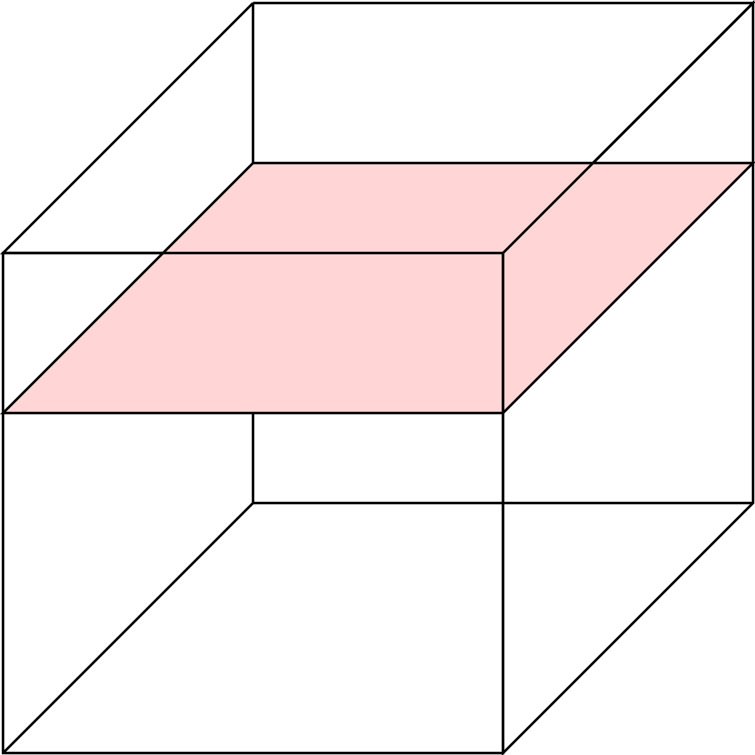
3D Quantum Hall Effect
z
Chern number n_{z}
independent of k_{z}
k_{z}
k_{y}
k_{x}
More generally, the 3 independent Chern numbers (n_{x},n_{y},n_{z}) define a reciprocal lattice vector G that characterizes a family of lattice planes.

Slide 21
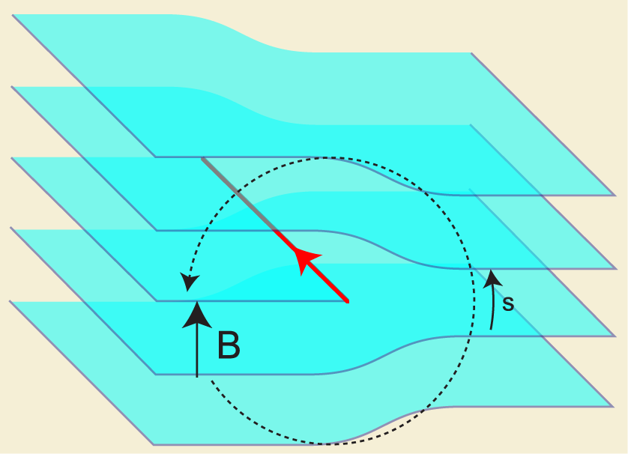
Topological Defects
Consider insulating Bloch Hamiltonians that vary slowly in real space
Teo, Kane ‘10
s
1 parameter family of 3D Bloch Hamiltonians
defect line
2nd Chern number :
Generalized bulk-boundary correspondence :
n specifies the number of chiral Dirac fermion modes bound to defect line
Example : dislocation in 3D layered IQHE
3D Chern number
(vector ┴ layers)
G_{c}
Are there other ways to engineer
1D chiral dirac fermions?
Burgers’ vector

Slide 22
Weyl Semimetal
Gapless “Weyl points” in momentum space are topologically protected in 3D
A sphere in momentum space can have a Chern number:
k
S
n_{S}=+1: S must enclose a degenerate Weyl point:
Magnetic monopole for Berry flux
E
k_{x,y,z}
Total magnetic charge in Brillouin zone must be zero: Weyl points
must come in +/- pairs.

Slide 23
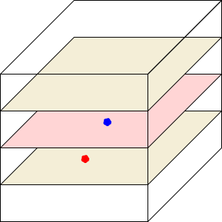
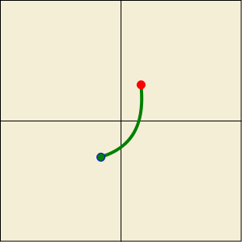
Surface Fermi Arc
E
n₁=n₂=0
E_{F}
k_{z}=k₁, k₂
k₂
k_{y}
k_{z}
E
k₀
k₁
n₀=1
E_{F}
k_{y}
k_{z}=k₀
k_{x}
k_{y}
k_{z}
Surface BZ
k_{y}

Slide 24
Chiral Anomaly
In the presence of E and B, the charge at one (or the other) Weyl
point is not conserved:

